Slide 1


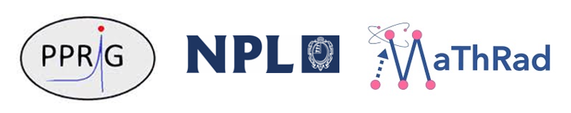
DNA damage models of different complexity levels do not predict fundamental differences in the induction or repair of damage
Shannon Thompson
9th November 2023

Slide 2
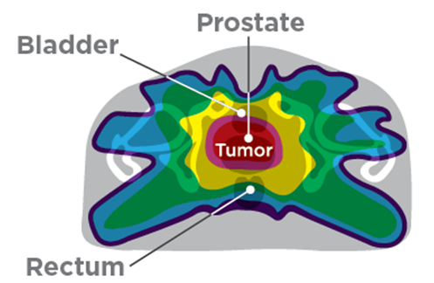
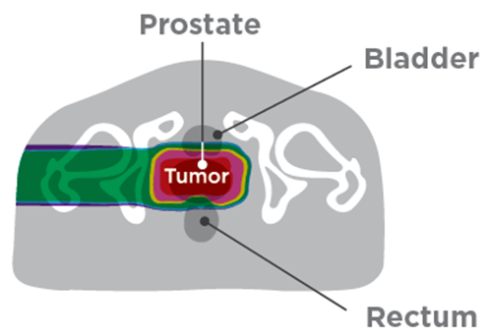
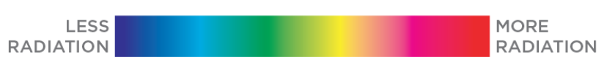
Radiation therapy
X-rays
Protons
Proton therapy
Superior tumour targeting
Higher linear energy transfer (LET)
Better biological response
Magnitude of increase uncertain
Computational models
Simulate DNA damage and repair
Compare biological effectiveness of different radiation treatments
Image sourced from lp.knoxvilleproton.com

Slide 3
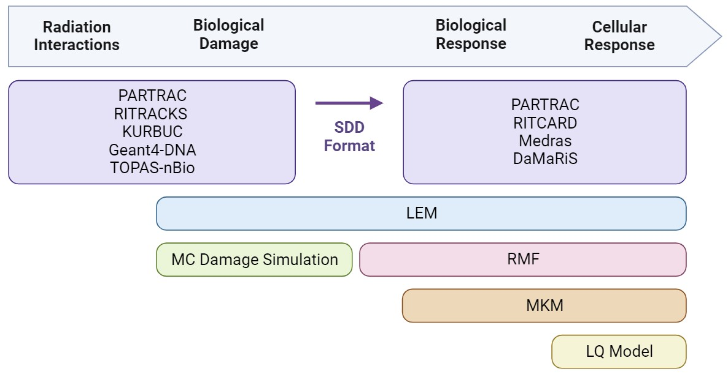
Computational modelling of radiation response
Mechanistic models
Simulate various radiation exposures:
Physical interactions
Chemical interactions
Nuclear and DNA geometries
Strand break and base damage
Double strand break (DSB) damage
DSB repair kinetics
Formation of chromosome aberrations
Cell response

Slide 4
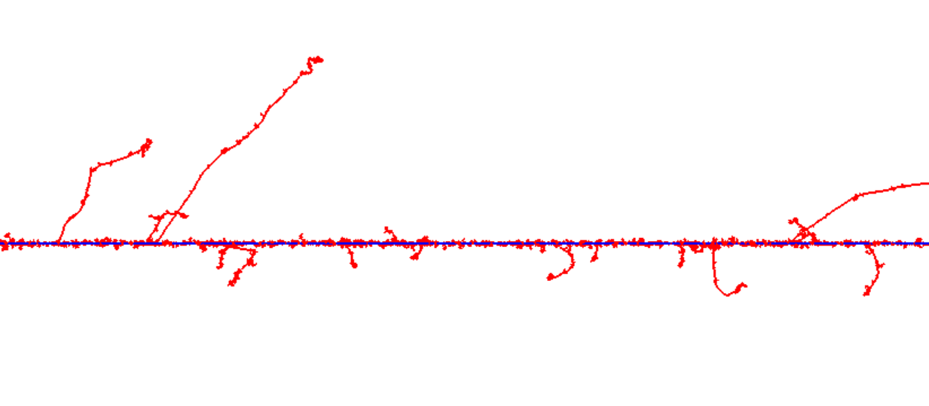
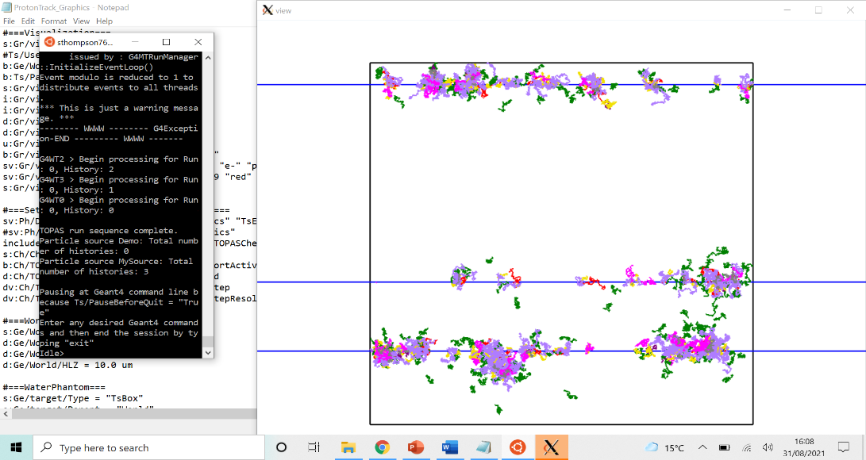
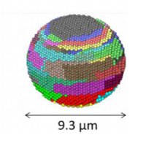

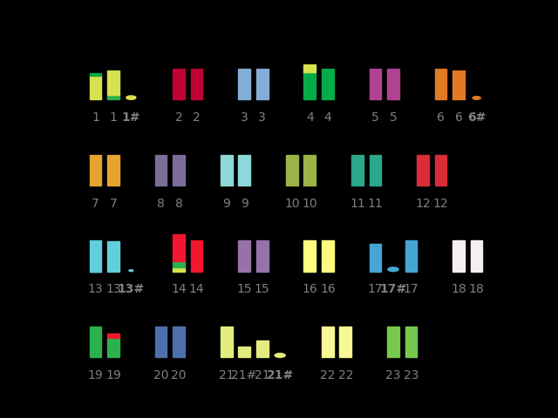
Modelling DNA damage and repair
Chemical track
Physical interactions
Chemical interactions
Proton track
Biological geometries
DSB damage
Double strand breaks (DSBs) within 10 bp
DSB repair
NHEJ, HR, MMEJ
Nucleus¹
Cell response
Chromosome aberrations
1. Zhu et al. 2020 Phys. Med. Biol.

Slide 5
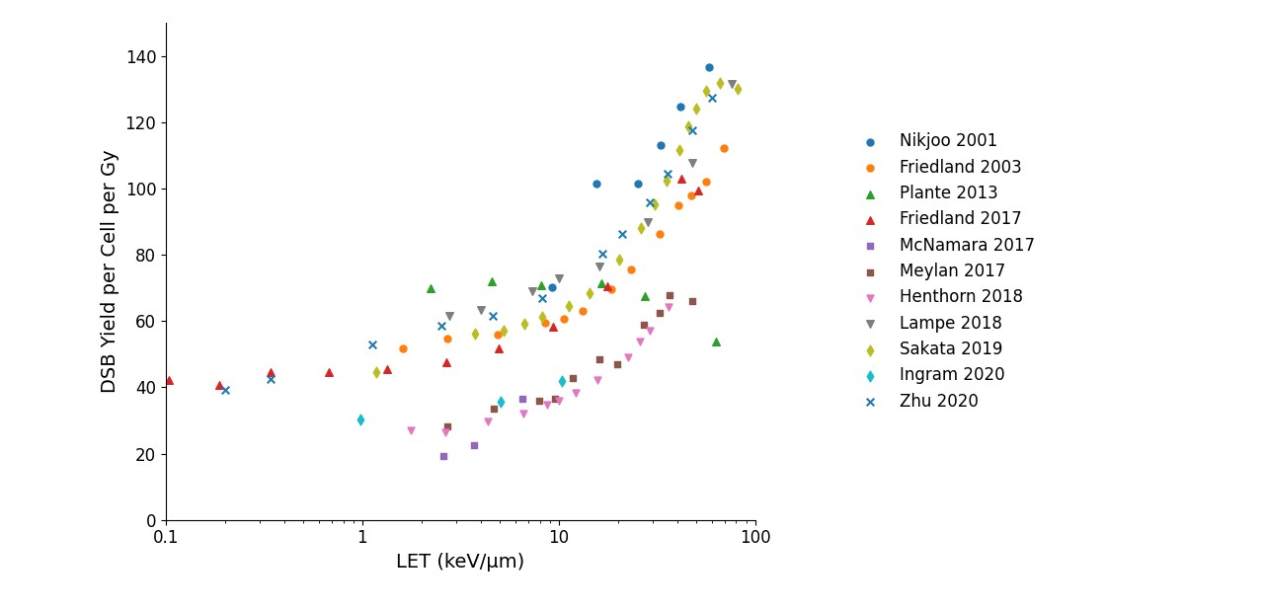
Predicting DSB damage
Reference | Physical model | Chemistry | Biological geometries
(Nikjoo et al 2001) | KURBUC | Yes | Canonical B-DNA linear segments
(Friedland et al 2003) | PARTRAC | Yes | Fibroblast cell nucleus
(Plante et al 2013) | RITRACKS | No | Cubic phantom
(Friedland et al 2017) | PARTRAC | Yes | Lymphocyte cell nucleus
(McNamara et al 2017) | Topas-nBio | No | Circular DNA plasmid
(Meylan et al 2017) | Geant4-DNA | Yes | Fibroblast cell nucleus
(Henthorn et al 2018) | DaMaRiS | No | Empty spherical phantom, sensitive fraction
(Lampe et al 2018) | Geant4-DNA | Yes | E. coli bacterial cell
(Sakata et al 2019) | Geant4-DNA | Yes | Fractal chromatin based human cell nucleus
(Ingram et al 2020) | DaMaRiS | No | Chromosome structure, Hi-C
(Zhu et al 2020) | TOPAS-nBio | Yes | Fibroblast cell nucleus
Monte Carlo models with different designs predict the same trend in DSB yield with proton LET
Easier to overcome differences in yields compared to differences in trends

Slide 6
Modelling DNA damage and repair
Topas-nBio
Radiation interactions and DNA damage
Physical interactions
Chemical interactions
- Various damage model detail
Biological geometries
DSB damage
Questions:
How do different model assumptions impact the predicted damage?
What is the damage model detail needed to accurately predict DNA damage in line with the experimental data?
DSB repair
Medras
Repair and response
- Simplified damage generator
Cell response

Slide 7
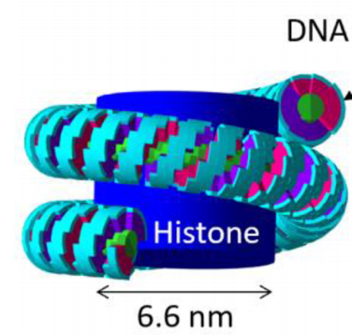
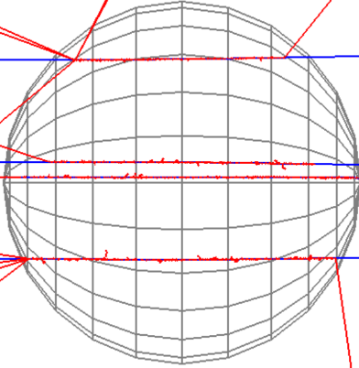
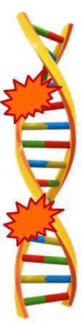
Damage models assumptions
Different model assumptions
  Inclusion of chemical interactions
  Realistic nucleus geometries
  Initial strand break damage
  Track structure detail
Realistic nucleus
All interactions
Radially symmetric energy distribution
Simple nucleus
Physical interactions – direct damage
SB₁
DSBs
> 10 bp
Chemical interactions
- indirect damage
SB₂

Slide 8
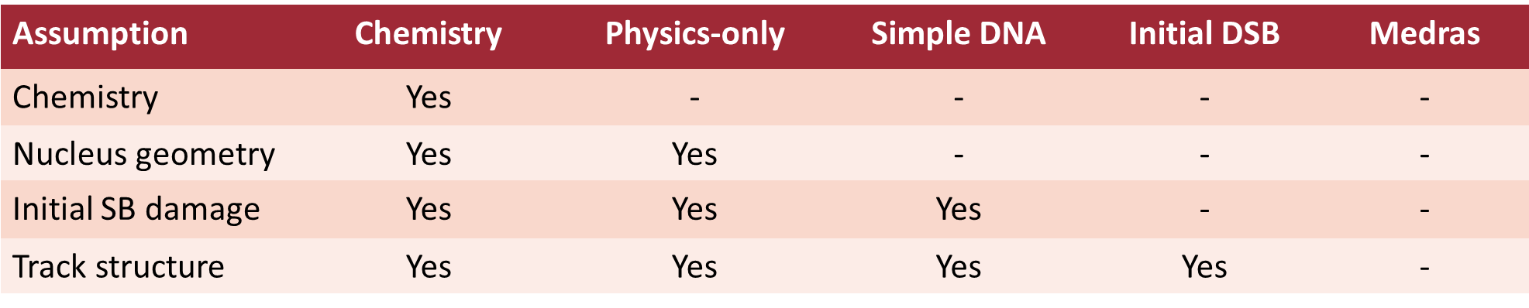
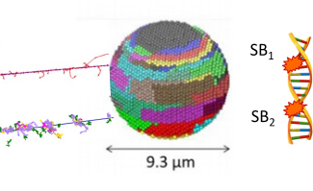
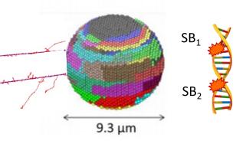
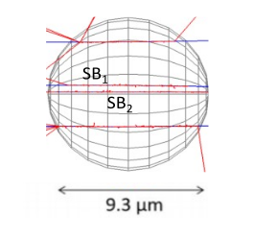
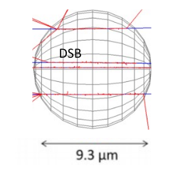
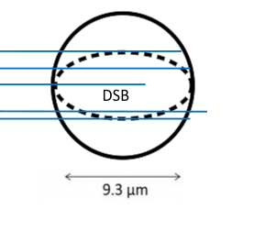
Damage models of different complexity
Chemistry
Physics-only
Simple DNA
Initial DSB
Medras
Reducing model detail and computational time

Slide 9
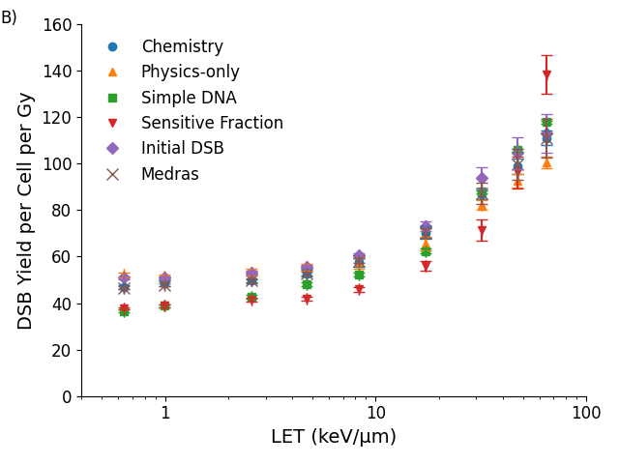
Damage model optimisation
Methods
1 Gy nucleus irradiation
Proton LET 0.6 – 60 keV/µm
Fit DSB yield of simpler models to most realistic chemistry model
Damage models agree for proton DSB yield
Removing model detail required updated damage definitions and parameters
Investigate possible changes in:
DSB distribution and complexity
DSB repair & chromosome aberrations

Slide 10
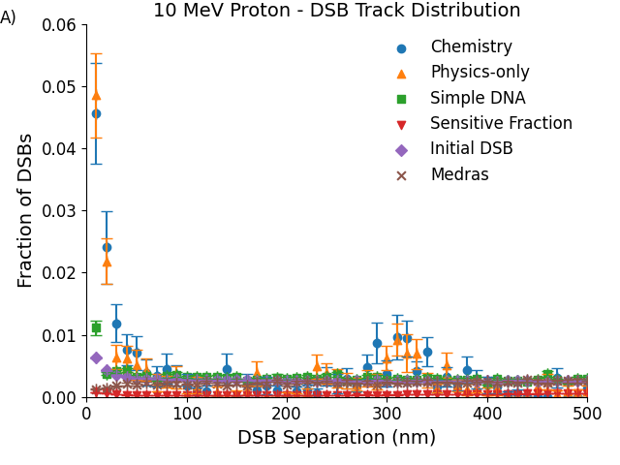
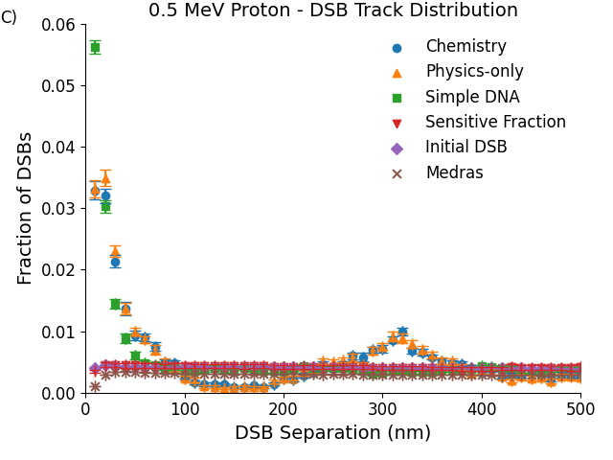
Double strand break distribution
Differences due to nuclear geometry, more defined at higher LETs
Changes in DSB positions at close separations could impact misrepair probability and biological response

Slide 11
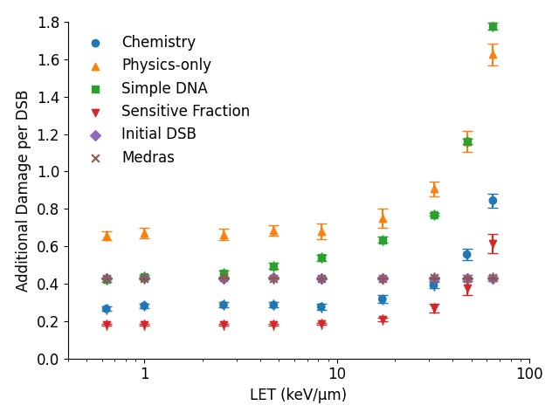
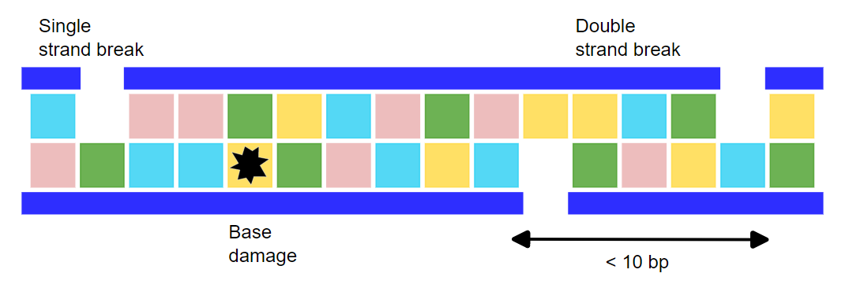
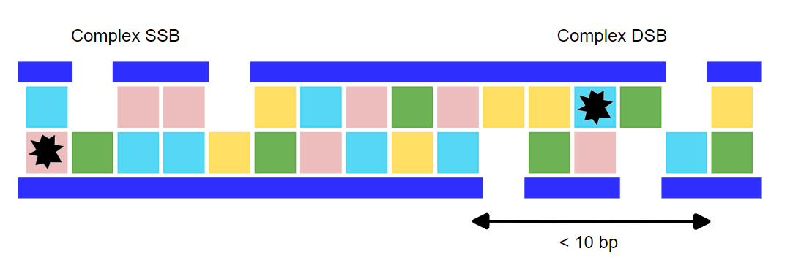
Double strand break complexity
Complex DSBs more difficult to repair
– impact misrepair probability and biological response
Models with same DSB yield have different DSB complexities – different biological response predicted?

Slide 12
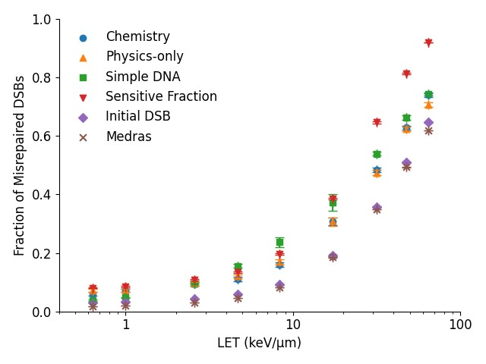
Double strand break repair
Simulated repair of DSB damage
Small differences in the fraction of misrepaired DSBs, increases with LET
Impact on the formation of lethal chromosome aberrations?

Slide 13
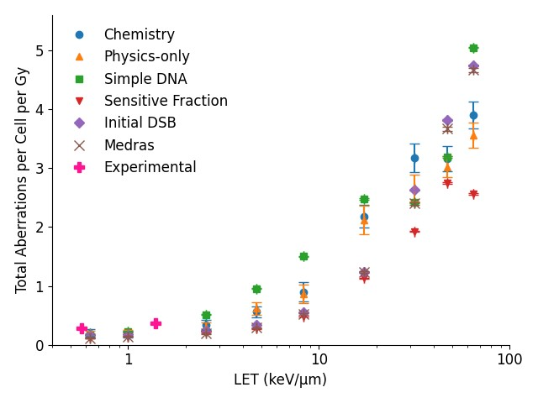
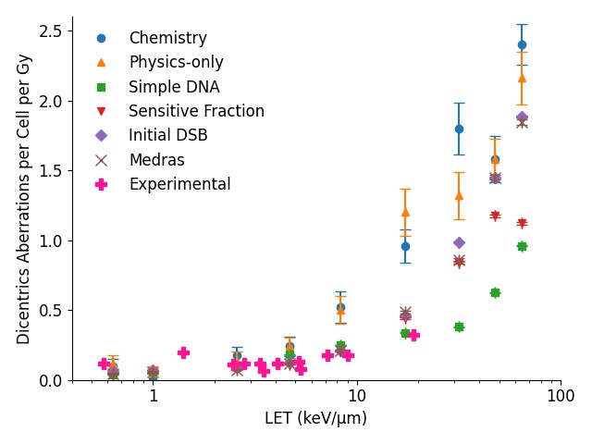
Chromosome aberrations
Models predict similar trends in aberration yields despite varying levels of simulation detail

Slide 14
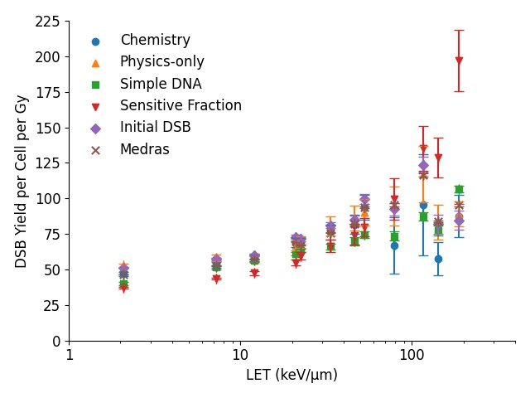
Alpha and carbon ion exposures – DSB yield
Check agreement in predicted damage for models optimised for proton irradiations
Alpha LET: 2-188 keV/µm
Carbon LET: 12-142 keV/µm
Predicted similar trends in DSB yields

Slide 15
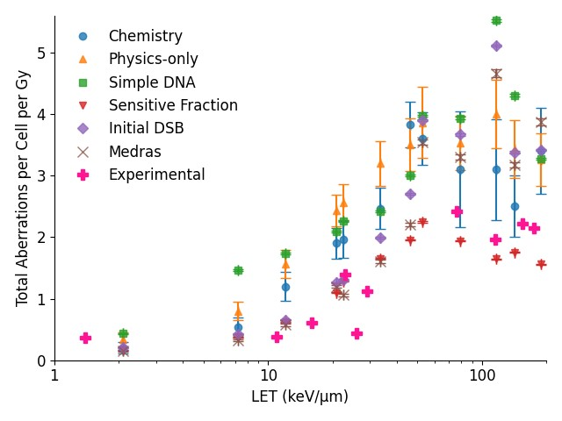
Alpha and carbon ion exposures – chromosome aberrations
Predicted similar trends in chromosome aberrations across radiation exposures
Over predicted compared to experimental literature but could be brought into better agreement
More complex models do not predict fundamental differences in damage
Simpler models can be optimised to have a similar predictive accuracy

Slide 16
Summary
Optimised damage models
Proton DSB yield
Predicted biological response
Impact of complexity and distribution
Validated model optimisation
Heavy ion exposures
Experimental validation
DSB & chromosome aberrations
Key result
Simpler models have the same predictive accuracy
Purpose
Identify model improvements for clinical research

Slide 17

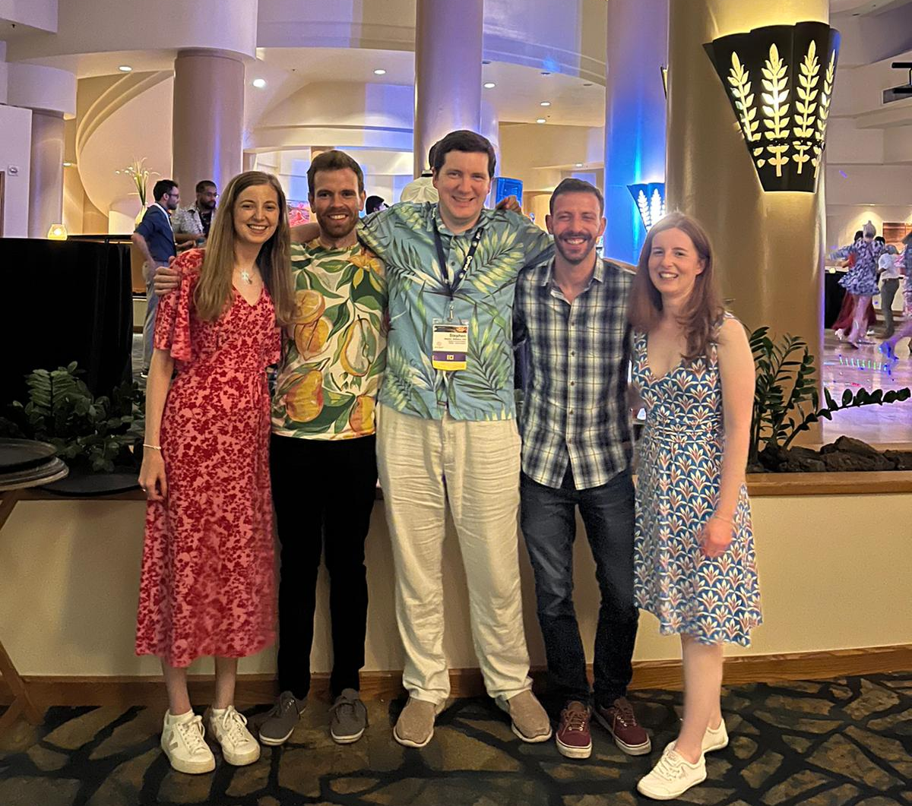
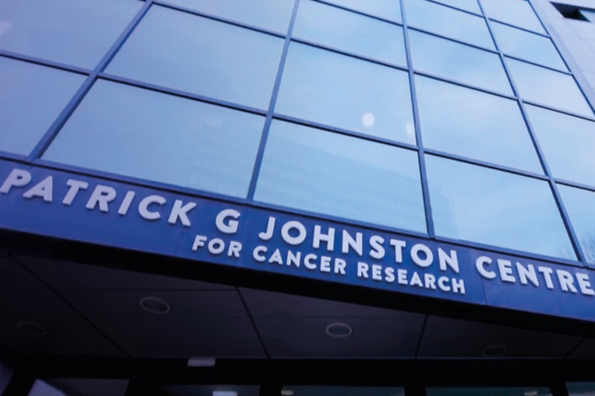


Acknowledgements
The Patrick G Johnston Centre for Cancer Research
Computational Radiobiology Group
Stephen McMahon
Kevin Prise
Karl Butterworth
Francisco Guerra Liberal
John O’Connor
Lydia Gardner
Mohammed Dakheel

